Slide 1

LIBRARY MANAGEMENT SYSTEM

Slide 2



Personal BACKGROUND
Name : Chandra Sagar C M
Qualification : B.tech CSE Graduate, PES University
www.collaberadigital.com

Slide 3


Key Takeaways/Learnings from the Program (HTD)
Learned how to build a complete application from scratch using Spring Boot and React
Got hands-on practice with microservices, service registry, and API gateway
Understood how to secure applications with login, authentication, and proper validations
Improved my database design and integration skills using MSSQL
Became more confident in testing APIs with Postman and handling real-world scenarios
Picked up good coding habits like writing clean, modular, and error-free code
Learned how to solve problems step by step through user stories
Gained valuable teamwork and project execution experience

Slide 4

Problem Statement of the Capstone Project
Managing a library manually is time-consuming and error-prone. Administrators often struggle with keeping track of catalogues, members, circulation, acquisitions, and reviews. The challenge is to build a digital Library Management System (LMS) that makes these tasks easier, faster, and more reliable.
The goal of the project is to create a full-stack solution using Spring Boot microservices on the backend and React on the frontend, with secure authentication, smooth data flow, and efficient search and management features.

Slide 5
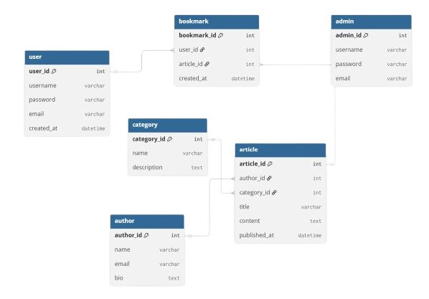
ER Diagram

Slide 6
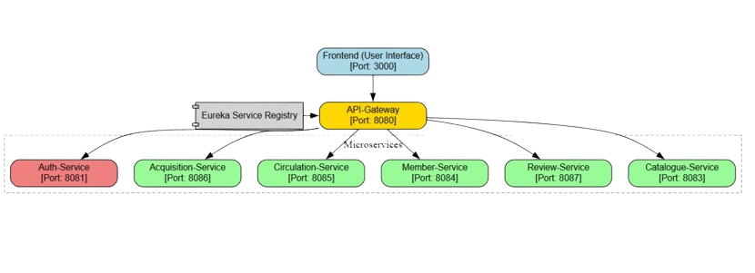
Architecture Diagram

Slide 7
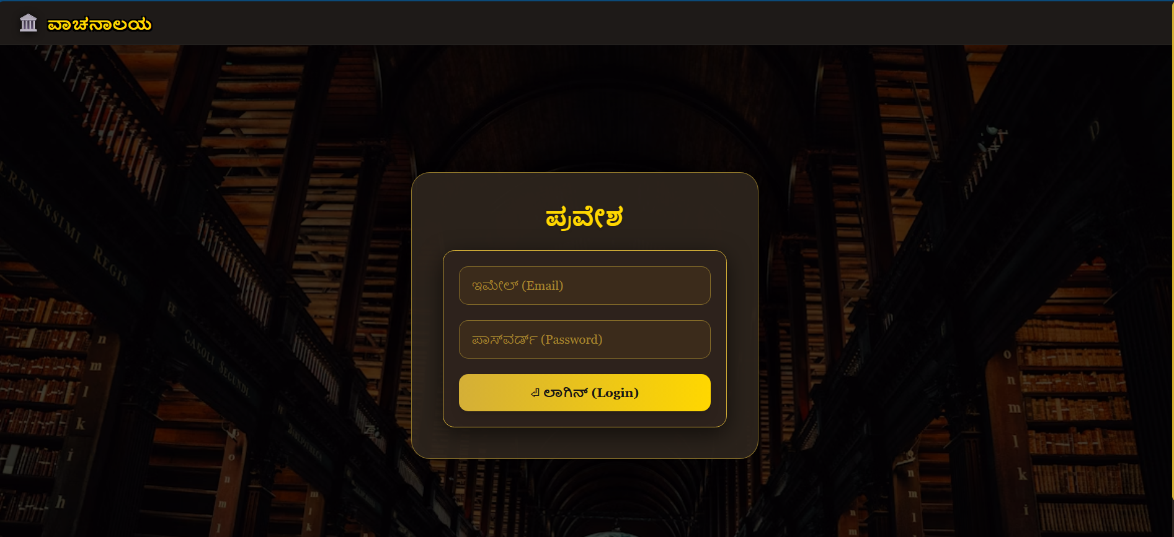

Slide 8
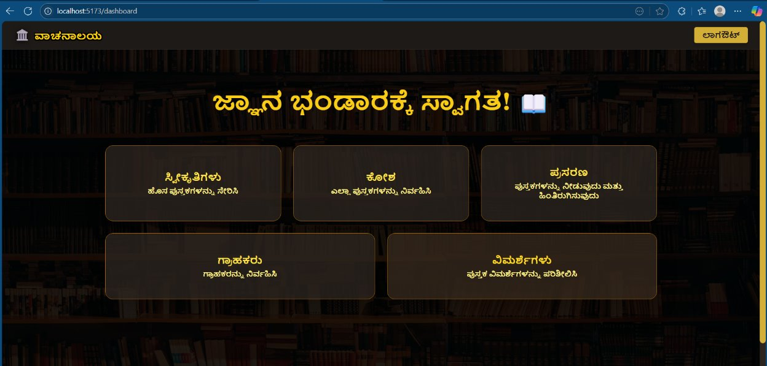

Slide 9
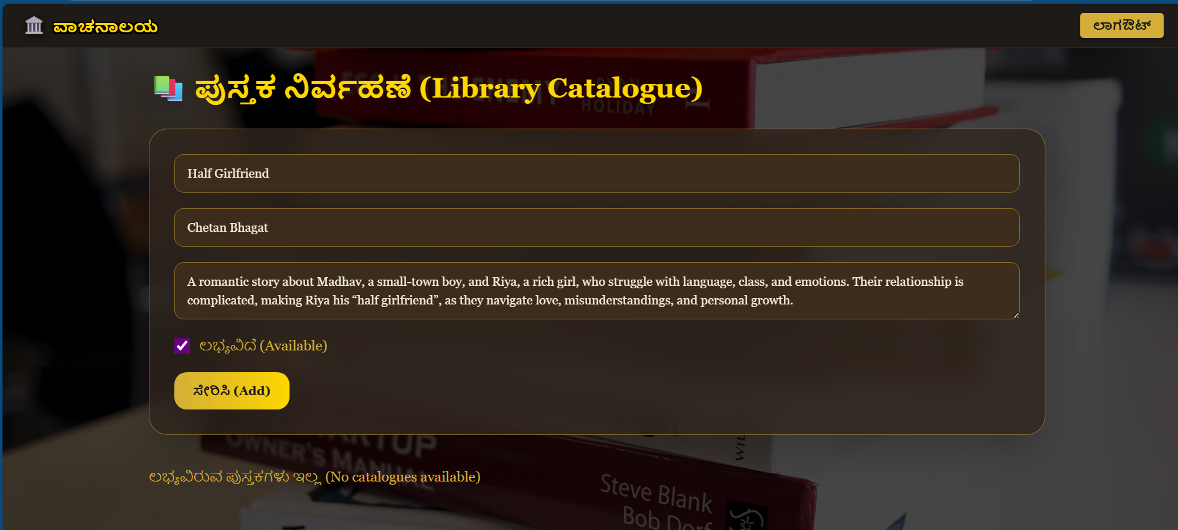

Slide 10
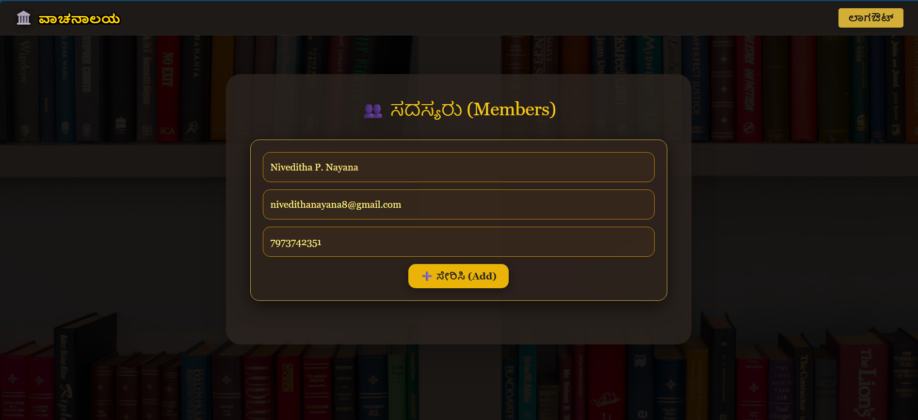

Slide 11
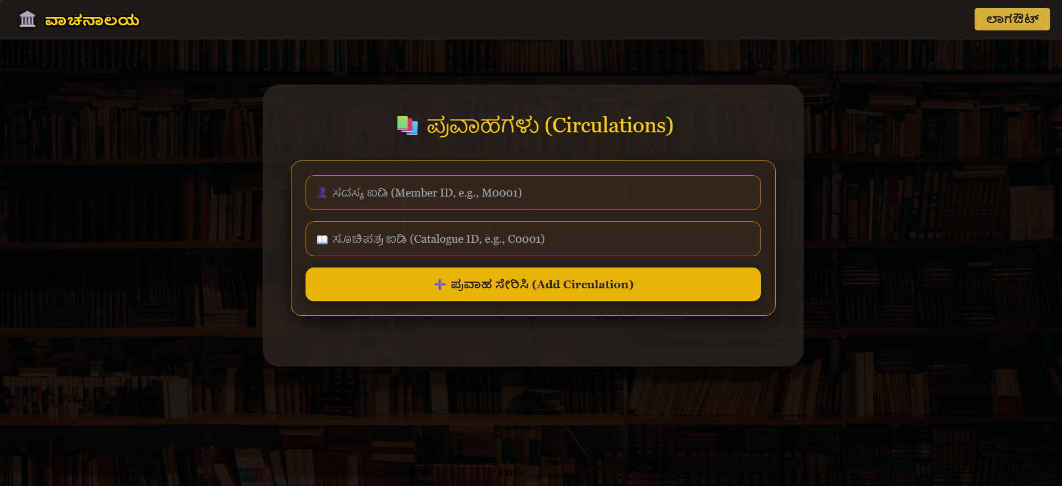

Slide 12
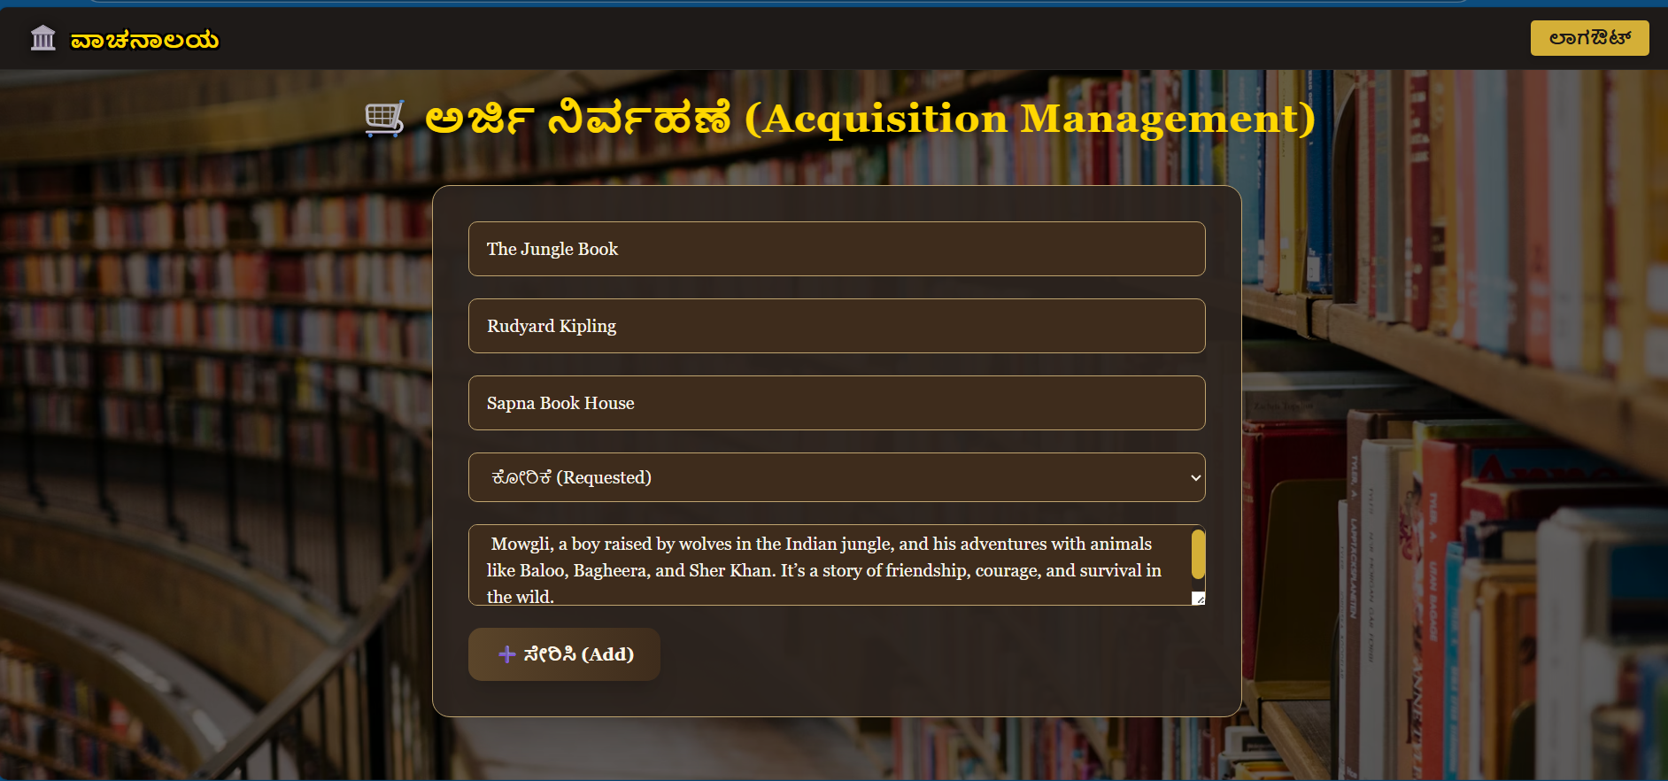

Slide 13
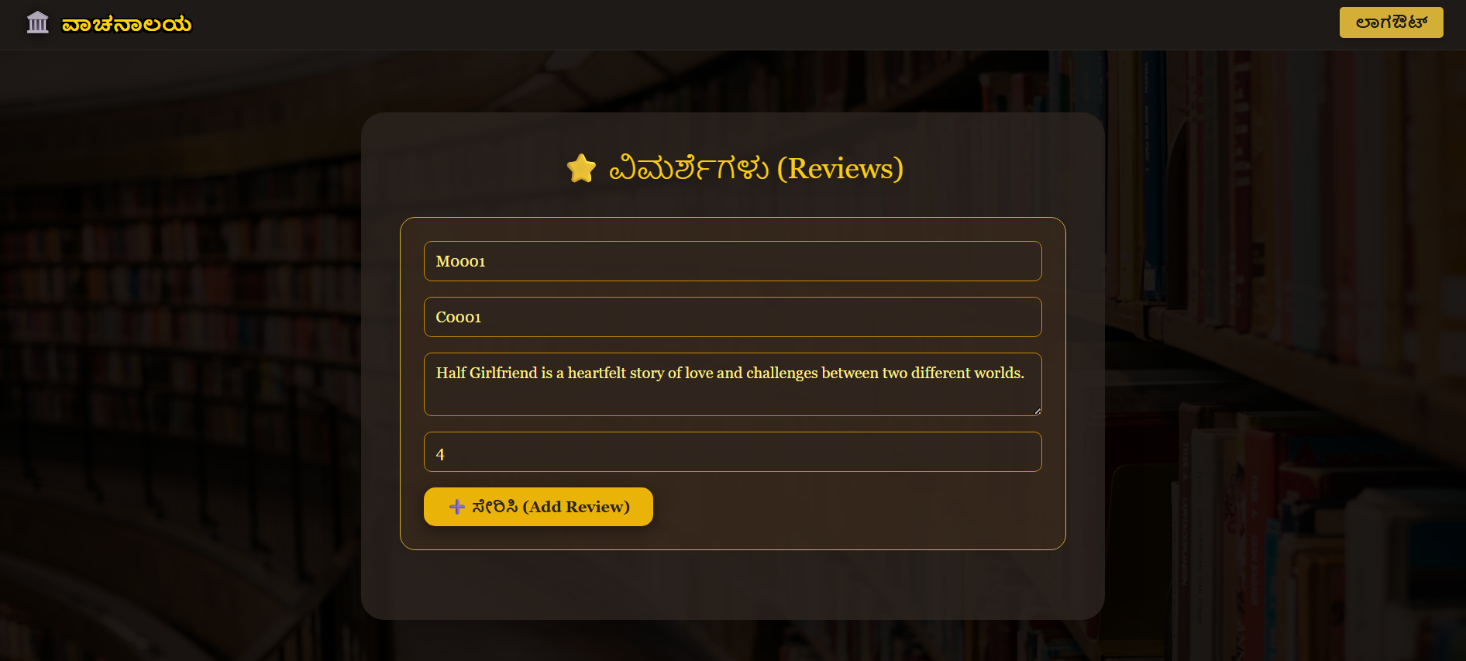

Slide 14
Conclusion
The Capstone Project gave me the opportunity to bring together everything I learned during the program and apply it in a real-world scenario. By developing a complete Library Management System, I was able to work on all layers of a full stack application — from designing the database, building secure backend services with Spring Boot, to creating a responsive frontend with React.
Through this project, I understood how different components like microservices, API gateway, service registry, and authentication come together to form a scalable system. I also learned how to test APIs effectively, handle exceptions, and ensure data integrity.
Most importantly, this project improved my ability to think through problems step by step, follow best coding practices, and collaborate effectively. It gave me the confidence to take on larger projects in the future and design applications that are practical, reliable, and impactful.

Slide 15
Thank You

